Slide 1
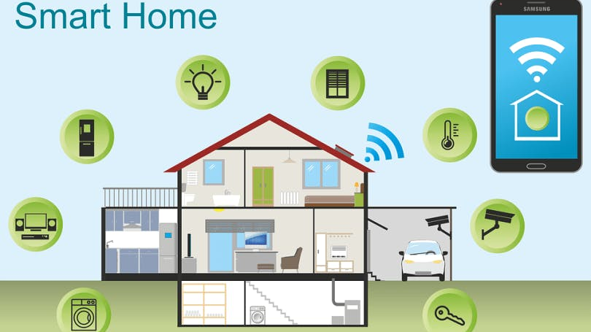
SIMPLE HOME AUTOMATION WITH SPEECH RECOGNITION

Slide 2
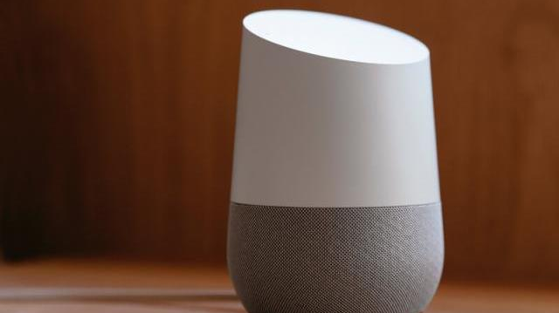
Introduction
Alexa, turn on the lights!
We don’t know about your home, but in our home, most things are automated; our lights turn on whenever we’re nearby, our coffee starts making itself in the morning, and our security system disarms whenever we’re almost home.
Not only are these features convenient, but they also save us energy and thus, money on utility bills. But since home automation is a relatively new technology, some people may find it overwhelming.
Let’s see What is Home Automation!!

Slide 3
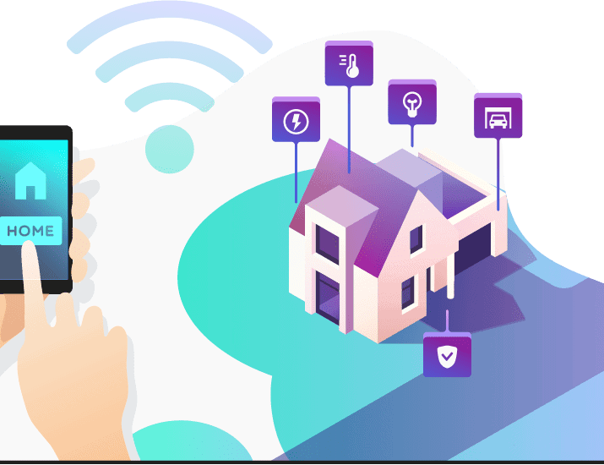
What is Home Automation?
Home automation is the automatic control of electronic devices in your home.
These devices are connected to the Internet, which allows them to be controlled remotely.
With home automation, devices can trigger one another so you don’t have to control them manually via an app or voice assistant.
For example, you can put your lights on schedules so that they turn off when you normally go to sleep, or you can have your thermostat turn the A/C up about an hour before you return to work so you don’t have to return to a stuffy house. Home automation makes life more convenient and can even save you money on heating, cooling and electricity bills.

